Slide 1
Facebook – Exploratory Data Analysis
By Data Diggers International

Slide 2
Table of Content
About the Data
Basic Analysis
Correlation Deep Dive
Inferences

Slide 3
I - pseudo_facebook.tsv
About the Data
# of Records | 99,003
# of Columns | 15
Srl# | Column Description | Data Type
1 | dob_year_dob_month_dob_day | datetime64[ns]
2 | userid | int64
3 | age | int64
4 | gender | object
5 | tenure | float64
6 | friend_count | int64
7 | friendships_initiated | int64
8 | likes | int64
9 | likes_received | int64
10 | mobile_likes | int64
11 | mobile_likes_received | int64
12 | www_likes | int64
13 | www_likes_received | int64
14 | tenure_mnth | float64
15 | tenure_yrs | float64

Slide 4
II - pseudo_facebook.tsv
About the Data
Columns | count | mean | std | min | 25% | 50% | 75% | max
age | 99003 | 37.28 | 22.59 | 13 | 20 | 28 | 50 | 113
tenure | 99001 | 537.89 | 457.65 | 0 | 226 | 412 | 675 | 3139
friend_count | 99003 | 196.35 | 387.30 | 0 | 31 | 82 | 206 | 4923
friendships_initiated | 99003 | 107.45 | 188.79 | 0 | 17 | 46 | 117 | 4144
likes | 99003 | 156.08 | 572.28 | 0 | 1 | 11 | 81 | 25111
likes_received | 99003 | 142.69 | 1387.92 | 0 | 1 | 8 | 59 | 261197
mobile_likes | 99003 | 106.12 | 445.25 | 0 | 0 | 4 | 46 | 25111
mobile_likes_received | 99003 | 84.12 | 839.89 | 0 | 0 | 4 | 33 | 138561
www_likes | 99003 | 49.96 | 285.56 | 0 | 0 | 0 | 7 | 14865
www_likes_received | 99003 | 58.57 | 601.42 | 0 | 0 | 2 | 20 | 129953
tenure_mnth | 99001 | 1.47 | 1.25 | 0 | 0.62 | 1.13 | 1.85 | 8.6
tenure_yrs | 99001 | 2.00 | 1.26 | 0 | 1 | 2 | 2 | 9

Slide 5
Basic Analysis

Slide 6
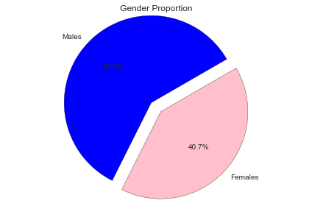
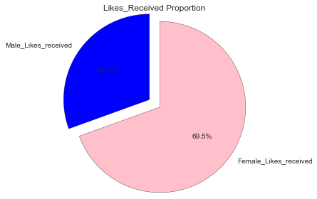
Demography of User Base
Basic Analysis I
Need a Histogram by the Age-Group
Male FB Users are still more than Female FB User by almost 9%
Significant User Base is in 100+ Age Category
Need a Histogram of Likes Received for Males and Females by the Age-Group

Slide 7
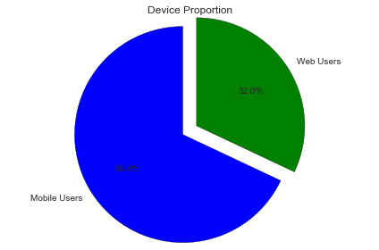
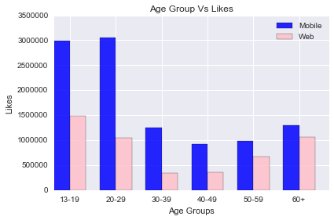
Demography of Devices
Basic Analysis II
FB Usage on Mobile Device is more than Double that thru browser (laptop/desktop)

Slide 8
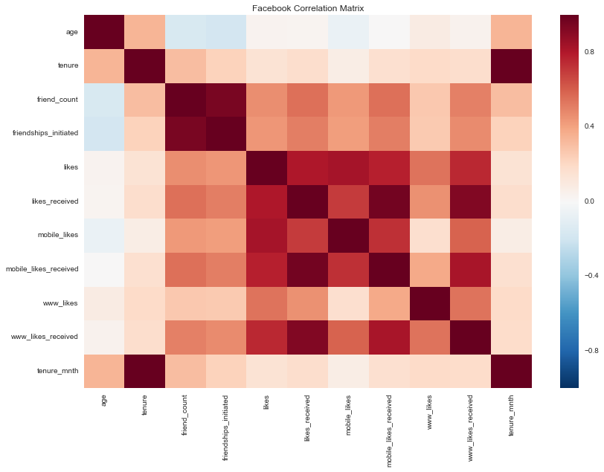
Basic Correlation Matrix
Basic Analysis III
Strong Correlations
“Friendship Initiated “and “Friend Count”
“Likes” and “Likes Received”

Slide 9
Correlation Deep-Dive

Slide 10
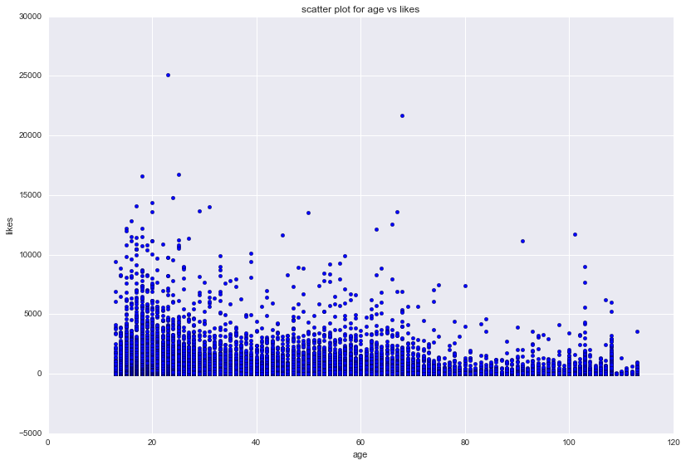
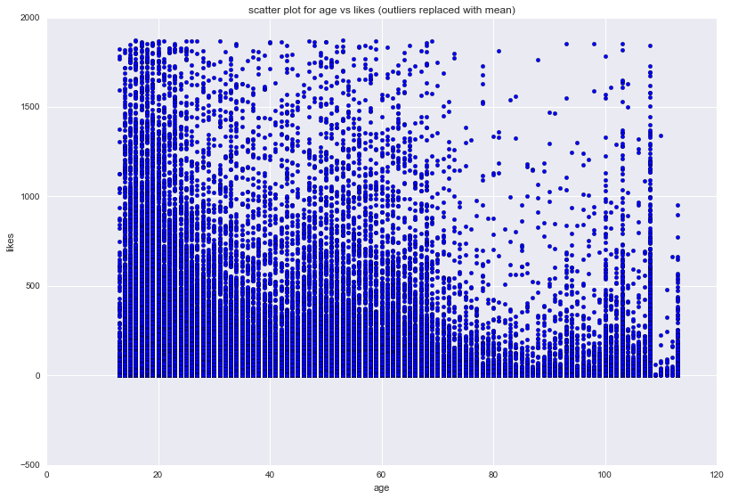
Facebook User Activity – By Age
Correlation Deep Dive I
Likes Activity by Age of Facebook User
Observation:
Activity Level is highest with the Millennials
Activity with FB User who are more than 100+ Years as well. Leads to doubt if there is some Issue with the data
Likes Activity by Age of Facebook User without Outliers
Observation:
Activity with FB User who are more than 100+ Years continues to be seen as Strong even for this case

Slide 11
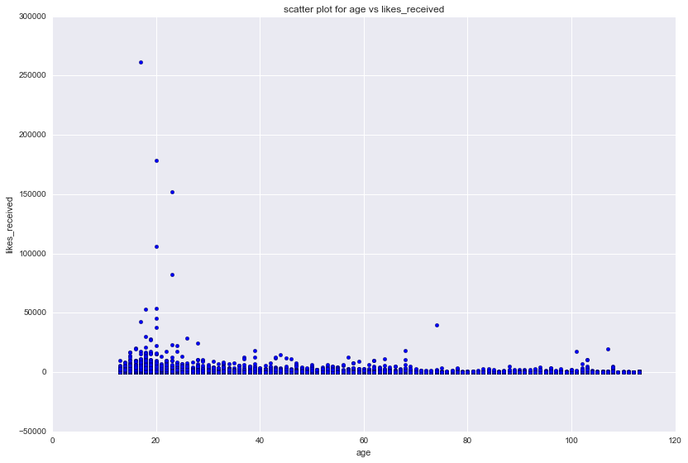
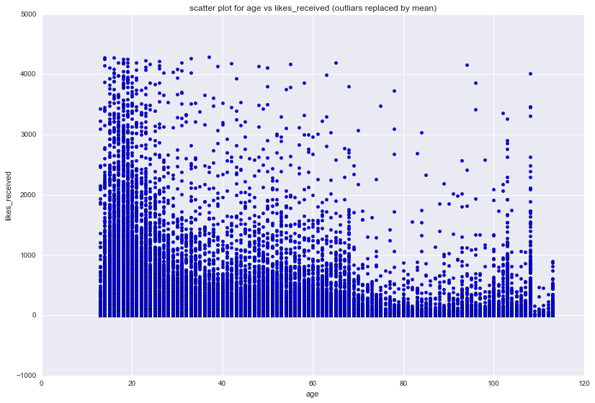
Facebook User Reaction – By Age
Correlation Deep Dive II
Likes Received by Age of Facebook User
Observation:
Activity Level is highest with the Millennials
Outliers makes the Data Visualization difficult
Likes Received by Age of Facebook User without Outliers
Observation:
Likes Received by FB User who are more than 100+ Years continues to be seen as Strong even for this case

Slide 12
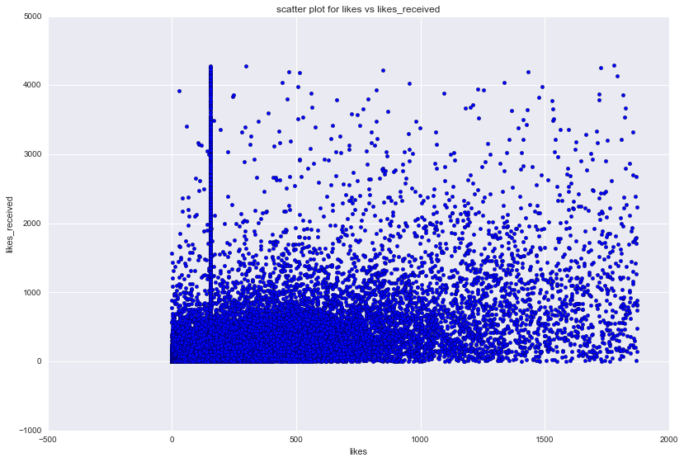
Liking Vs Liked
Correlation Deep Dive III
Likes Vs Likes Received
Observation:
Liking More things does NOT mean you will be liked back more

Slide 13
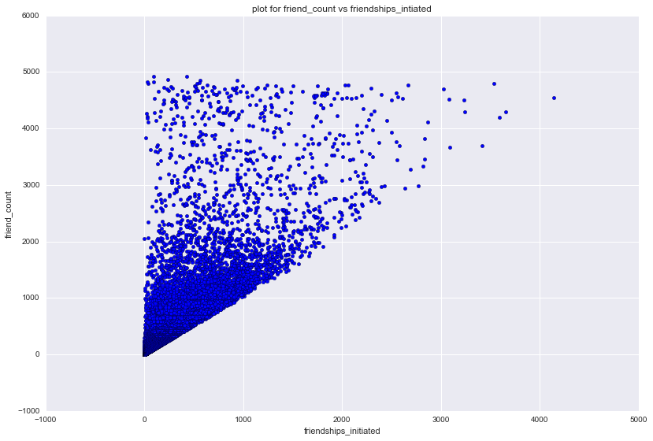
Friend Count vs Friendship Initiated
Correlation Deep Dive IV
Observation:
Most Users Have more Friend’s Than Friendship Initiated
Need Scatter Plot for Female
Need Scatter Plot for Male

Slide 14
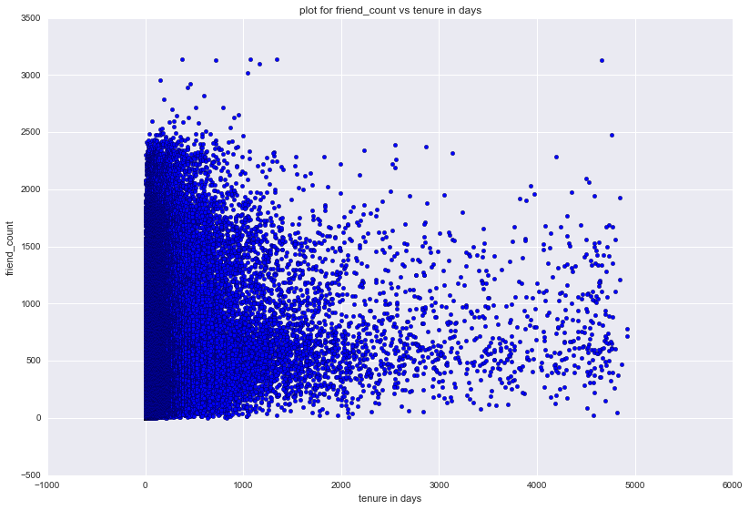
Friend Count Vs FB Age (in Months)
Correlation Deep Dive V
Observation:
More FB Age does not translate to More Friends. Rate of Increase in Network diminishes over time

Slide 15
Inference

Slide 16
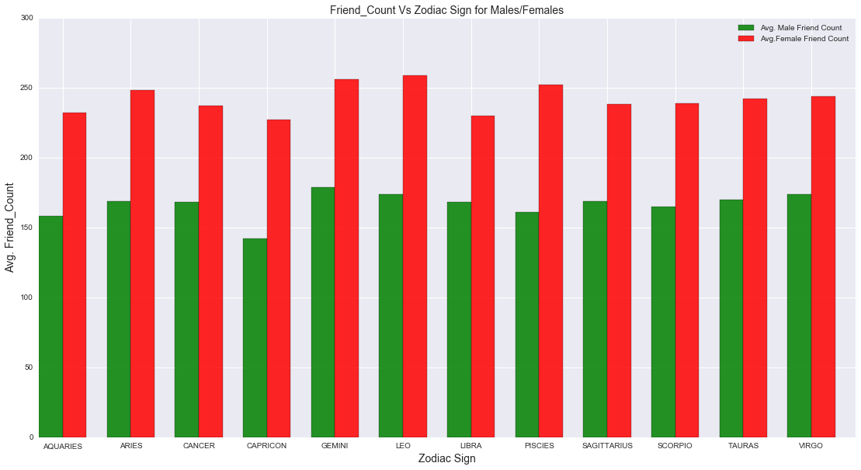
What has Stars to do about ones Social Likeability?
Inference I

Slide 17
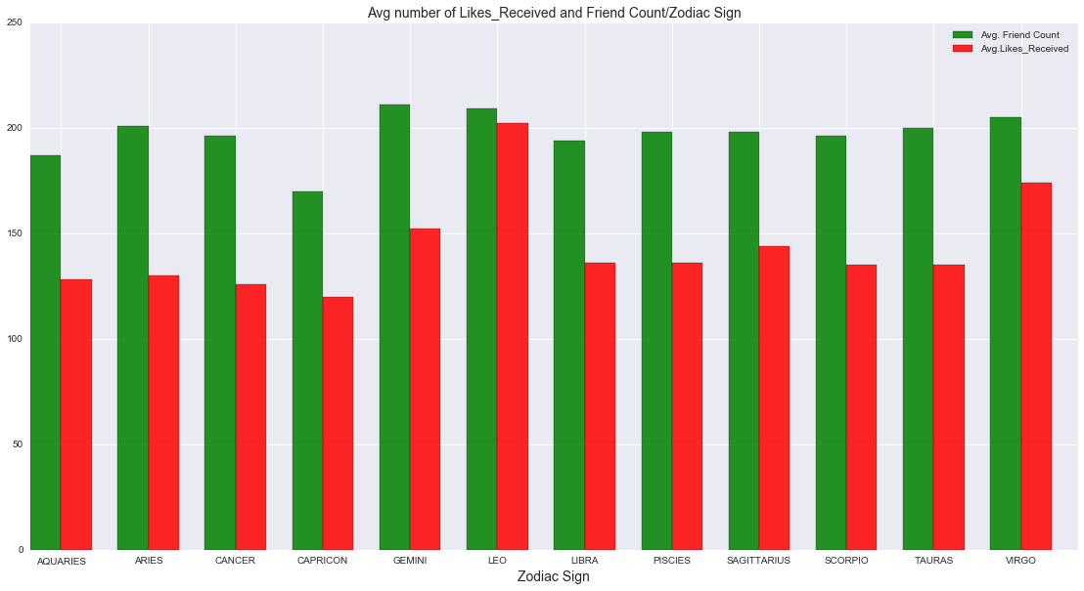
What has Stars to do about ones Social Likeability?
Inference I
Leo and Virgo gets more Likes than others

